Slide 1
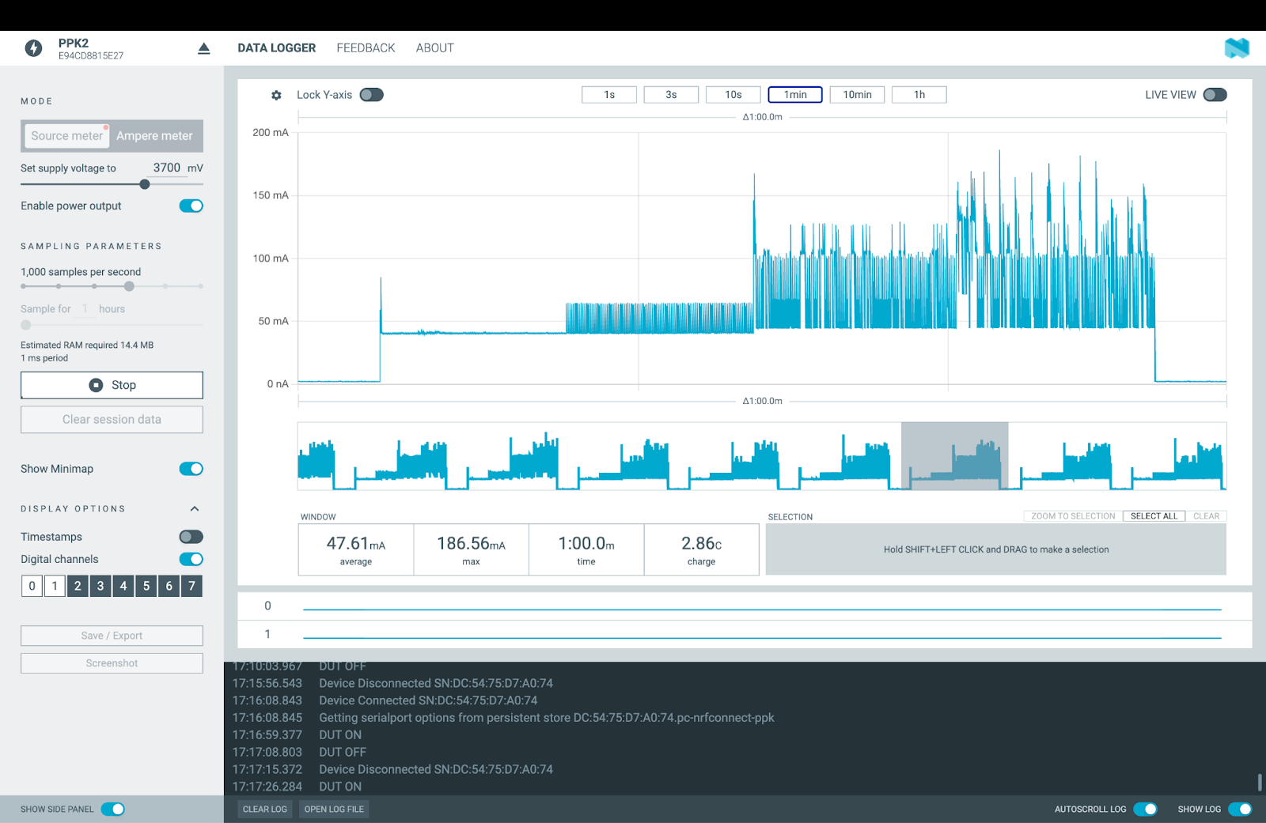
1. Idle ESP32
2. ultrasonic
3. Ultrasonic
+ Wi-Fi
4. Ultrasonic
+ Wi-Fi
+ data to Firebase
deepsleep
5. deepsleep

Slide 2
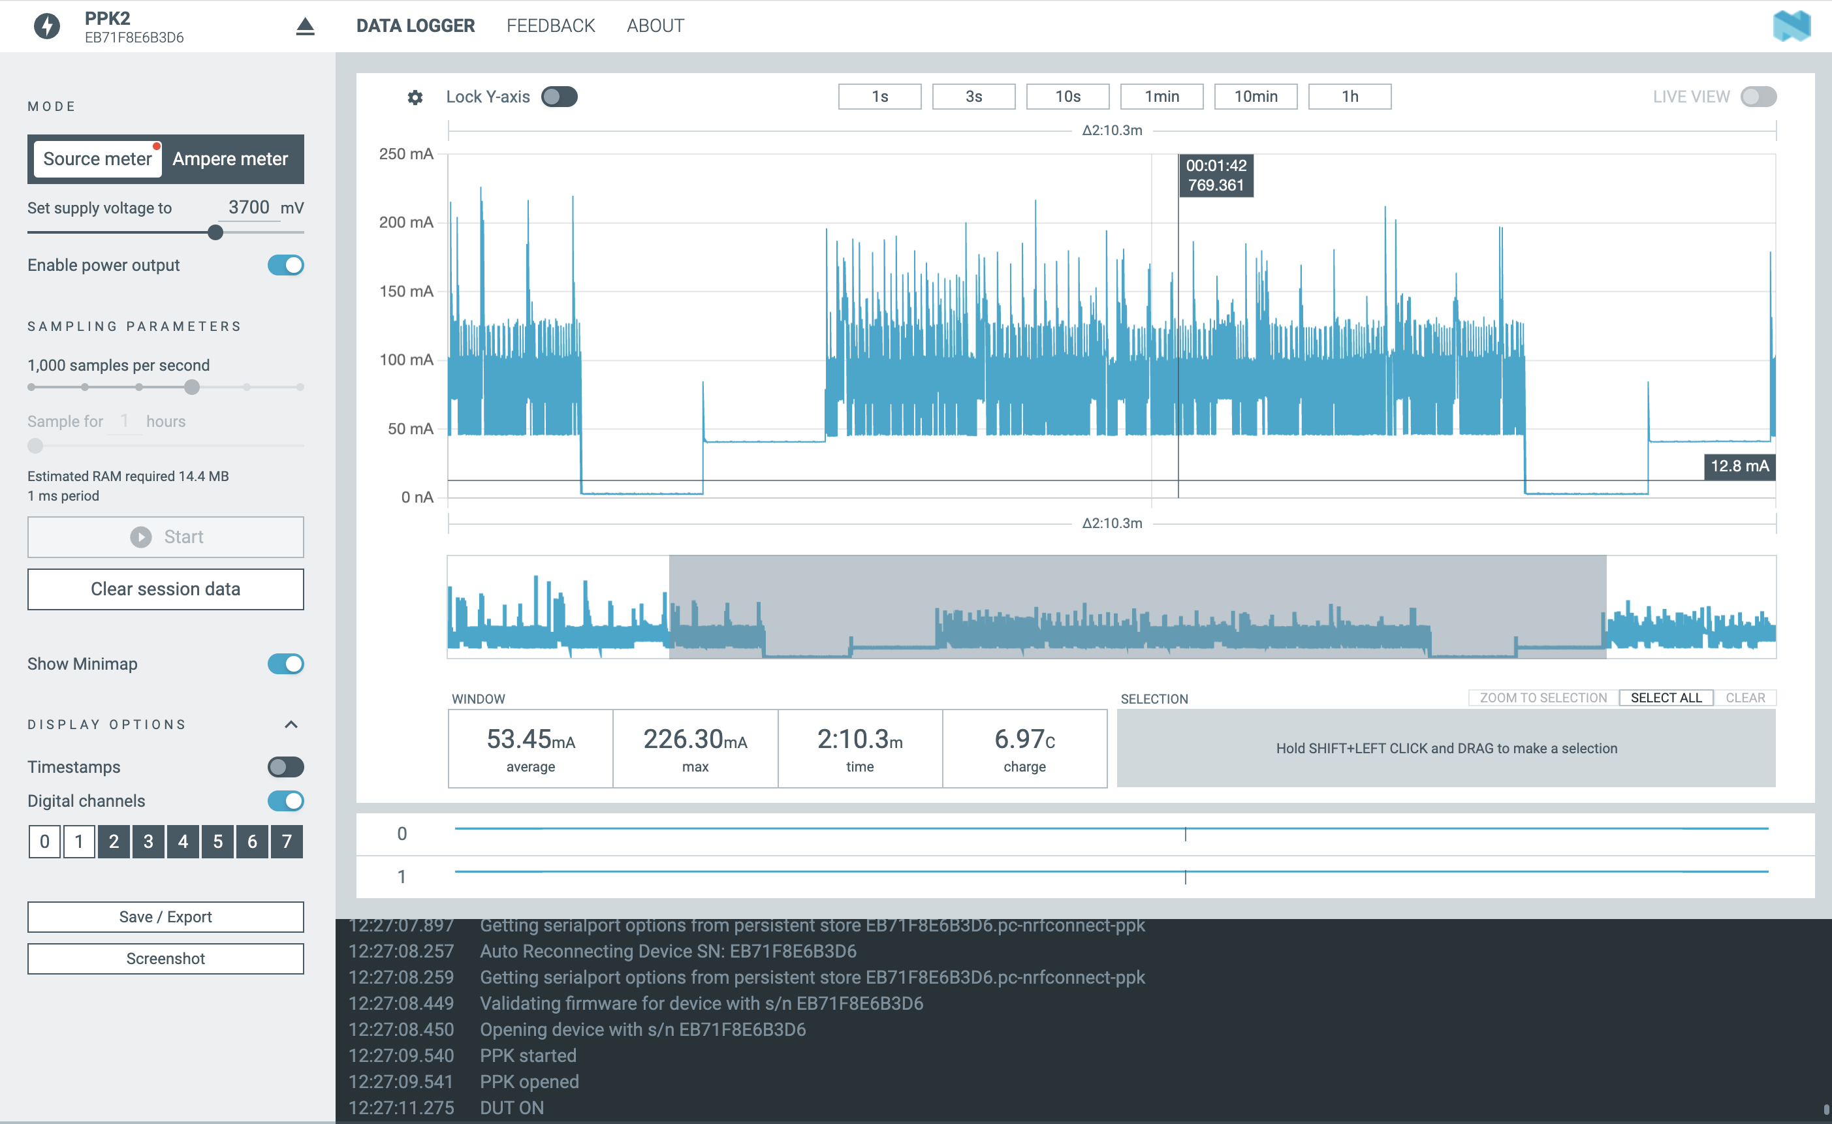
1. 2Hz
2. 1Hz
3. 0.5Hz
4. 0.333Hz
5. 0.25Hz

